Slide 1
My Perimeter, Area and Volume Interactive Notebook
Name
Class
Term 3 Semester 2

Slide 2
Contents
Formula Page
Page
Date
Description
2
3

Slide 3
Tasks
24
7
30
Essential Question
Questions
Notes
Summary
6
7

Slide 4
24
7
30
Date
Area
EQ – Describe the relationship between the radius, diameter and area?
7

Slide 5
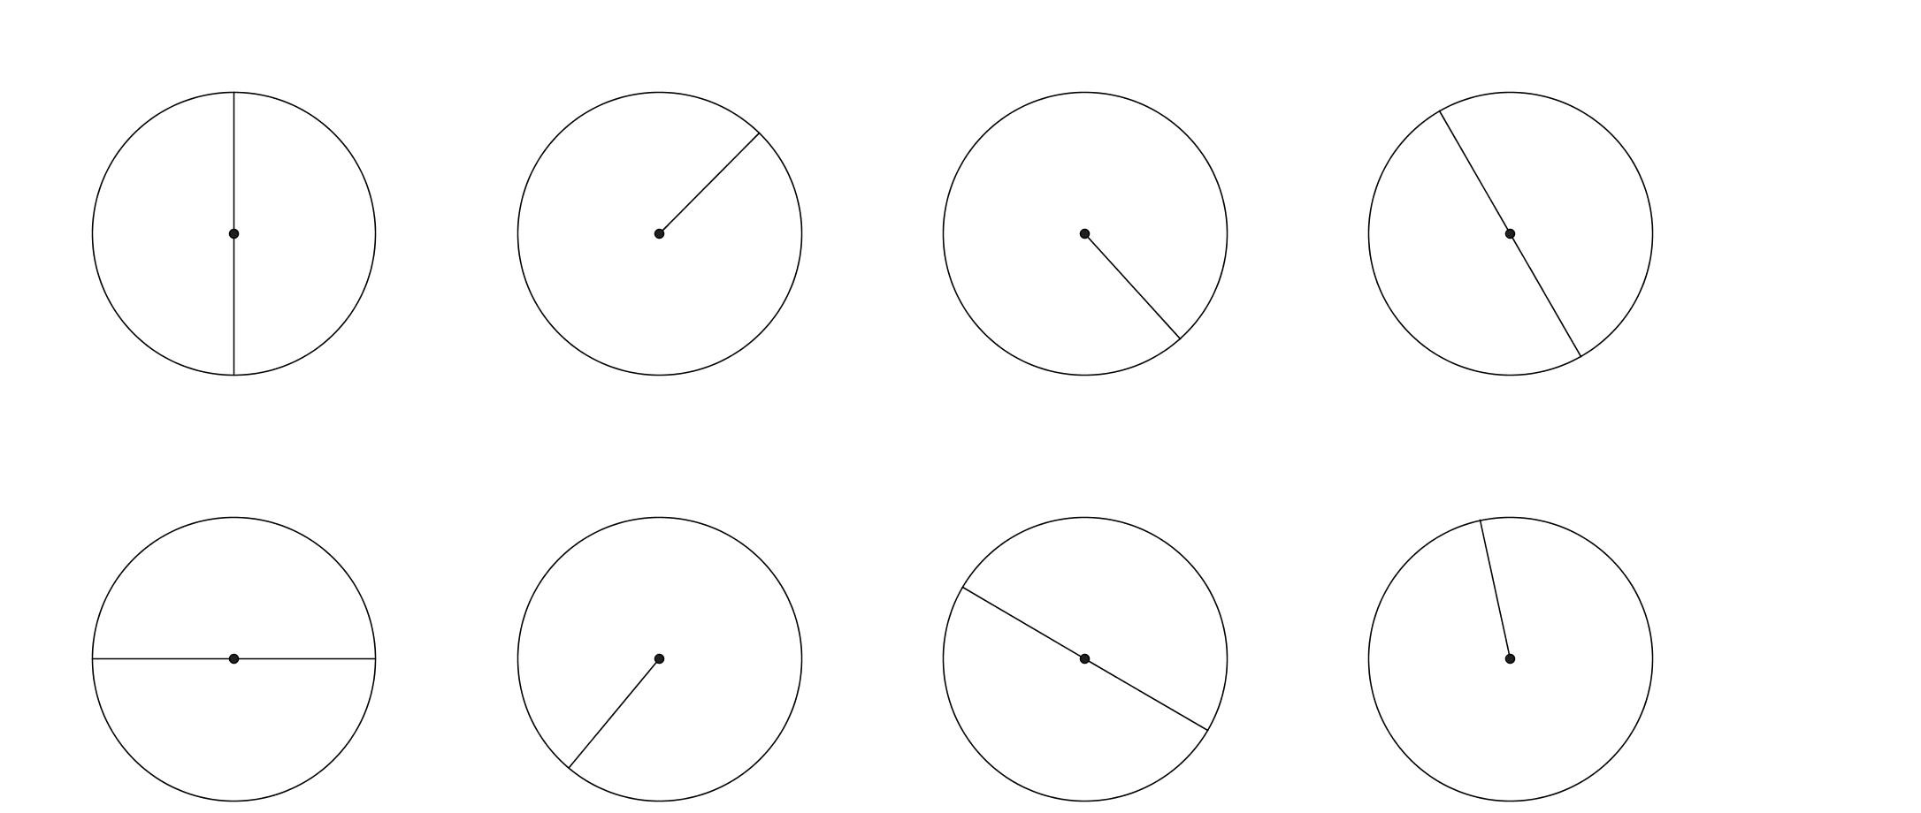
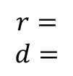
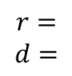
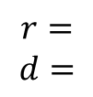
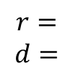
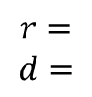
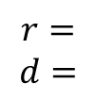
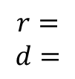
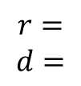
Task One- Write down the radius and diameter of each circle.
7m
10m
25cm
26mm
$$r=$$
$$d=$$
$$r=$$
$$d=$$
$$r=$$
$$d=$$
$$r=$$
$$d=$$
6.9cm
13.2mm
2.4m
0.8cm
$$r=$$
$$d=$$
$$r=$$
$$d=$$
$$r=$$
$$d=$$
$$r=$$
$$d=$$

Slide 6
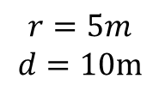
Task One- Write down the radius and diameter of each circle.
7m
10m
26mm
25cm
$$r=5m$$
$$d=10m$$
$$r=$$
$$d=$$
$$r=$$
$$d=$$
$$r=$$
$$d=$$
6.9cm
13.2mm
2.4m
0.8cm
$$r=$$
$$d=$$
$$r=$$
$$d=$$
$$r=$$
$$d=$$
$$r=$$
$$d=$$

Slide 7
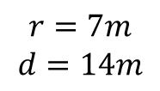
Task One- Write down the radius and diameter of each circle.
7m
10m
26mm
25cm
$$r=5m$$
$$d=10m$$
$$r=7m$$
$$d=14m$$
$$r=$$
$$d=$$
$$r=$$
$$d=$$
6.9cm
13.2mm
2.4m
0.8cm
$$r=$$
$$d=$$
$$r=$$
$$d=$$
$$r=$$
$$d=$$
$$r=$$
$$d=$$

Slide 8
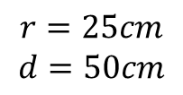
Task One- Write down the radius and diameter of each circle.
7m
10m
26mm
25cm
$$r=5m$$
$$d=10m$$
$$r=7m$$
$$d=14m$$
$$r=25cm$$
$$d=50cm$$
$$r=$$
$$d=$$
6.9cm
13.2mm
2.4m
0.8cm
$$r=$$
$$d=$$
$$r=$$
$$d=$$
$$r=$$
$$d=$$
$$r=$$
$$d=$$

Slide 9
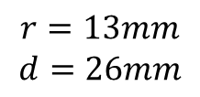
Task One- Write down the radius and diameter of each circle.
7m
10m
26mm
25cm
$$r=5m$$
$$d=10m$$
$$r=7m$$
$$d=14m$$
$$r=25cm$$
$$d=50cm$$
$$r=13mm$$
$$d=26mm$$
6.9cm
13.2mm
2.4m
0.8cm
$$r=$$
$$d=$$
$$r=$$
$$d=$$
$$r=$$
$$d=$$
$$r=$$
$$d=$$

Slide 10
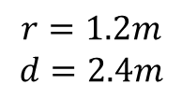
Task One- Write down the radius and diameter of each circle.
7m
10m
26mm
25cm
$$r=5m$$
$$d=10m$$
$$r=7m$$
$$d=14m$$
$$r=25cm$$
$$d=50cm$$
$$r=13mm$$
$$d=26mm$$
6.9cm
13.2mm
2.4m
0.8cm
$$r=1.2m$$
$$d=2.4m$$
$$r=$$
$$d=$$
$$r=$$
$$d=$$
$$r=$$
$$d=$$

Slide 11
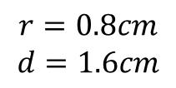
Task One- Write down the radius and diameter of each circle.
7m
10m
26mm
25cm
$$r=5m$$
$$d=10m$$
$$r=7m$$
$$d=14m$$
$$r=25cm$$
$$d=50cm$$
$$r=13mm$$
$$d=26mm$$
6.9cm
13.2mm
2.4m
0.8cm
$$r=1.2m$$
$$d=2.4m$$
$$r=0.8cm$$
$$d=1.6cm$$
$$r=$$
$$d=$$
$$r=$$
$$d=$$

Slide 12
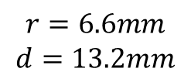
Task One- Write down the radius and diameter of each circle.
7m
10m
26mm
25cm
$$r=5m$$
$$d=10m$$
$$r=7m$$
$$d=14m$$
$$r=25cm$$
$$d=50cm$$
$$r=13mm$$
$$d=26mm$$
6.9cm
13.2mm
2.4m
0.8cm
$$r=1.2m$$
$$d=2.4m$$
$$r=0.8cm$$
$$d=1.6cm$$
$$r=6.6mm$$
$$d=13.2mm$$
$$r=$$
$$d=$$

Slide 13
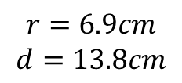
Task One- Write down the radius and diameter of each circle.
7m
10m
26mm
25cm
$$r=5m$$
$$d=10m$$
$$r=7m$$
$$d=14m$$
$$r=25cm$$
$$d=50cm$$
$$r=13mm$$
$$d=26mm$$
6.9cm
13.2mm
2.4m
0.8cm
$$r=1.2m$$
$$d=2.4m$$
$$r=0.8cm$$
$$d=1.6cm$$
$$r=6.6mm$$
$$d=13.2mm$$
$$r=6.9cm$$
$$d=13.8cm$$

Slide 14
24
7
30
Date
Area of Circles
EQ – Describe the relationship between the radius, diameter and area?
7

Slide 15
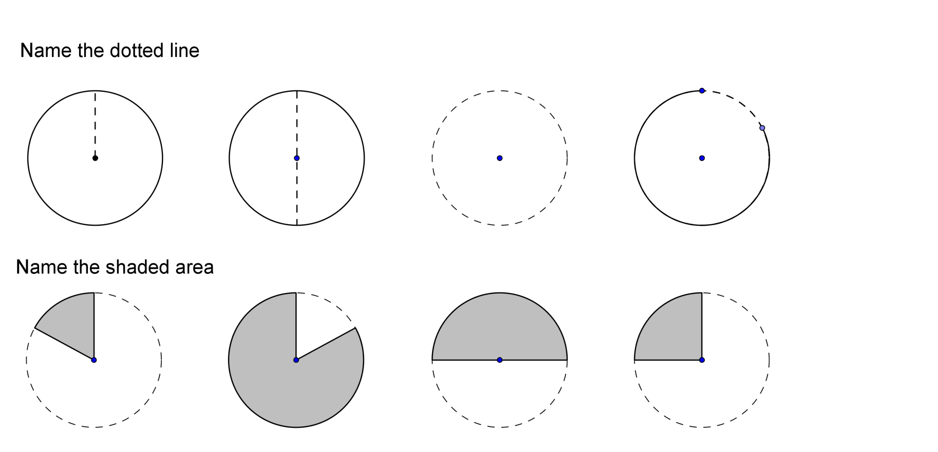
24
7
30
Date
Area of circles
EQ – Describe the relationship between the radius, diameter and area?
r
Radius
7

Slide 16
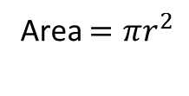
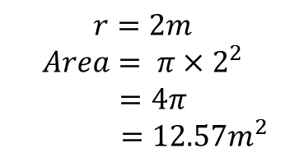
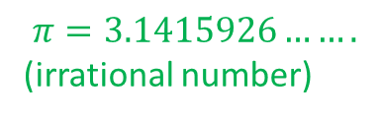
24
7
30
Date
Area of Circles
EQ – Describe the relationship between the radius, diameter and area?
r
Radius
Area $=πr^{2}$
$$π=3.1415926…….$$
(irrational number)
Find the area of the circle(answers to 2.d.p)
$$r=2m$$
$$Area= π×2^{2}$$
$$=4π$$
$$=12.57m^{2}$$
2m
7

Slide 17
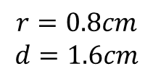
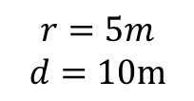
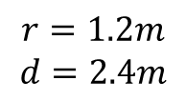
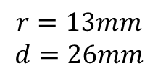
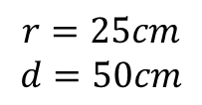
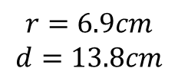
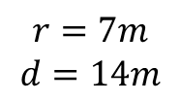
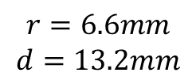
Task One- Find the area of the circles.(answers to 2.d.p)
7m
10m
26mm
25cm
$$r=5m$$
$$d=10m$$
$$r=7m$$
$$d=14m$$
$$r=25cm$$
$$d=50cm$$
$$r=13mm$$
$$d=26mm$$
6.9cm
2.4m
13.2mm
0.8cm
$$r=1.2m$$
$$d=2.4m$$
$$r=0.8cm$$
$$d=1.6cm$$
$$r=6.6mm$$
$$d=13.2mm$$
$$r=6.9cm$$
$$d=13.8cm$$

Slide 18
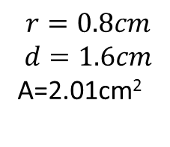
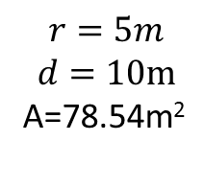
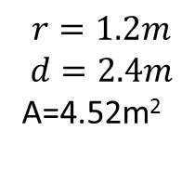
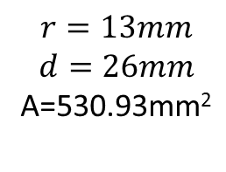
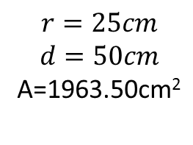
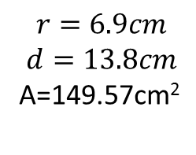
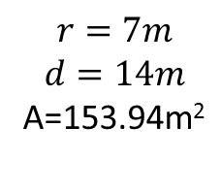
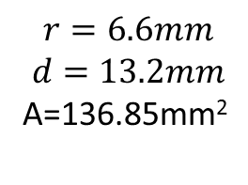
Task One- Find the area of the circles.(answers to 2.d.p)
7m
10m
26mm
25cm
$$r=5m$$
$$d=10m$$
A=78.54m²
$$r=7m$$
$$d=14m$$
A=153.94m²
$$r=25cm$$
$$d=50cm$$
A=1963.50cm²
$$r=13mm$$
$$d=26mm$$
A=530.93mm²
6.9cm
2.4m
13.2mm
0.8cm
$$r=1.2m$$
$$d=2.4m$$
A=4.52m²
$$r=0.8cm$$
$$d=1.6cm$$
A=2.01cm²
$$r=6.6mm$$
$$d=13.2mm$$
A=136.85mm²
$$r=6.9cm$$
$$d=13.8cm$$
A=149.57cm²

Slide 19
Notes Review
24, 7 ,30
Date
Title
Essential question
Notes complete
Notes complete with colour and diagrams
Questions completed
Contents page filed in
Formula page filled in

Slide 20
Homework
Review your notes and write a summary answering the essential question.

